Slide 1
Agents and Environments Lecture 2
Jim Rehg
January 16, 2016
College of Computing
Georgia Tech
(Slides based in part on slides from Andrea Thomaz)

Slide 2
Remaining Administrative Items
Resources
Review of Syllabus

Slide 3
Resources
Syllabus is now on T-Square, Piazza is coming soon
Text:
“AI: A Modern Approach,” 3rd edition (2010)
by Stuart Russell (UC Berkeley) & Peter Norvig (Google)
We will follow it reasonably closely in the beginning
Problems will be assigned from it
You must buy it

Slide 4
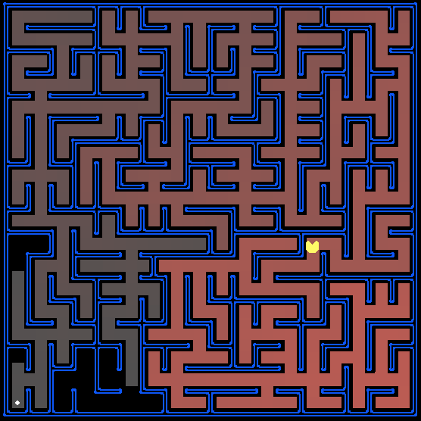
Grading
Midterm (30%)
Final (35%)
Projects (35%)
4 Graded Projects
1 Ungraded Project (Python Tutorial)
All projects done in Python (autograder)
No credit given for late submissions
Turn in on-time for Partial Credit
Honor Code: Projects are not collaborative, we test for cheating

Slide 5
Extra Credit
There will be opportunities for extra credit
Extra credit questions on all projects
Opportunities to participate in research studies
You must write a report
Don’t rely on this!
Start Early Start Early Start Early Start Early

Slide 6
Schedule and Disclaimer
A complete lecture schedule will be on T-Square by Friday
This schedule is subject to change
Any changes announced in class & via T-Square
I will miss some classes due to unavoidable travel
I will tell you where I am going and why ☺
My replacement lecturer will be highly trained (usually faculty)
I will provide pre-recorded lectures in every case

Slide 7
Agents as Functions
Agents Map States to Actions
Agent
Environment
Sensors
Percepts
?
Actions
Actuators

Slide 8

Tabletop Robot Example
State (perception) <Ball-loc, Sq-loc, Hand-loc> | Action <L, R, Pick(obj), Drop>
Ball-A, Sq-Hand, Hand-A
A
B
Notes:
Perception and Action States are both tuples, i.e. sets of discrete items

Slide 9
Tabletop Robot Example
State (perception) <Ball-loc, Sq-loc, Hand-loc> | Action <L, R, Pick(obj), Drop>
Ball-A, Sq-Hand, Hand-A | R
Ball-A, Sq-Hand, Hand-B
A
B
Notes:
Perception and Action States are both tuples, i.e. sets of discrete items

Slide 10
Tabletop Robot Example
State (perception) <Ball-loc, Sq-loc, Hand-loc> | Action <L, R, Pick(obj), Drop>
Ball-A, Sq-Hand, Hand-A | R
Ball-A, Sq-Hand, Hand-B | Drop
Ball-A, Sq-B, Hand-B
A
B
Notes:
Perception and Action States are both tuples, i.e. sets of discrete items

Slide 11
Rational Agent
Always chooses actions to get the Best Expected Outcome
How desirable is this action?
Need a task-dependent measure of performance
For a state sequence S, select action A which maximizes the performance measure
Ball-A, Sq-Hand, Hand-B
Drop
Ball-A, Sq-B, Hand-B

Slide 12
Task Setting
The problem the agent is trying to solve:
P – Performance Metric
E – Environment
A – Actuators
S – Sensors

Slide 13
Automated Taxi Problem (coming soon…)
P – ?
E – ?
A – ?
S – ?

Slide 14
Automated Taxi Problem (coming soon…)
P – Safe, fast, legal, max revenue, min cost, min fuel, …
E – city roads, traffic, pedestrians, bikers, construction, …
A – Car controls (steering, gas pedal) and human interface
S – Cameras, radar, laser rangefinder, GPS, mapping, engine sensors, human input devices

Slide 15
Environment Types
Fully Observable Partially Observable
Deterministic Stochastic
Episodic Sequential
Static Dynamic
Discrete Continuous
Single-Agent Multi-Agent

Slide 16
Summary
Agents map states to actions
States and actions represented as tuples
Agents should be rational
Select the action that maximizes the outcome
Task defined by PEAS
Performance metric, Environment, Actuation, Sensors
Environment Types influence the difficulty of the problem

Slide 17
Questions?

